Slide 1

GYMBUDD: A Web-based Application for Gym Enthusiast

Slide 2





The Proponents
Alfonso, Andrei P.
Santos, Jenny M.
Capili, Ryan M.
Siron, Maica G.
Project Manager
Programmer
Co-Programmer
Co-Programmer

Slide 3



1.0 INTRODUCTION
GYMBUDD: A Web-based Application for Gym Enthusiast

Slide 4
1.1 PROJECT CONTEXT
GYMBUDD: A Web-based Application for Gym Enthusiast

Slide 5


Slide 6


Slide 7


Slide 8

X

Slide 9
1.2 PURPOSE AND DESCRIPTION
GYMBUDD: A Web-based Application for Gym Enthusiast

Slide 10
1.3 OBJECTIVES
GYMBUDD: A Web-based Application for Gym Enthusiast

Slide 11
1.3.1 General Objectives
GYMBUDD: A Web-based Application for Gym Enthusiast

Slide 12
1.3.2 Specific Objectives
GYMBUDD: A Web-based Application for Gym Enthusiast

Slide 13
1.4 SCOPE AND LIMITATIONS
GYMBUDD: A Web-based Application for Gym Enthusiast

Slide 14
1.4.1 SCOPE
GYMBUDD: A Web-based Application for Gym Enthusiast

Slide 15
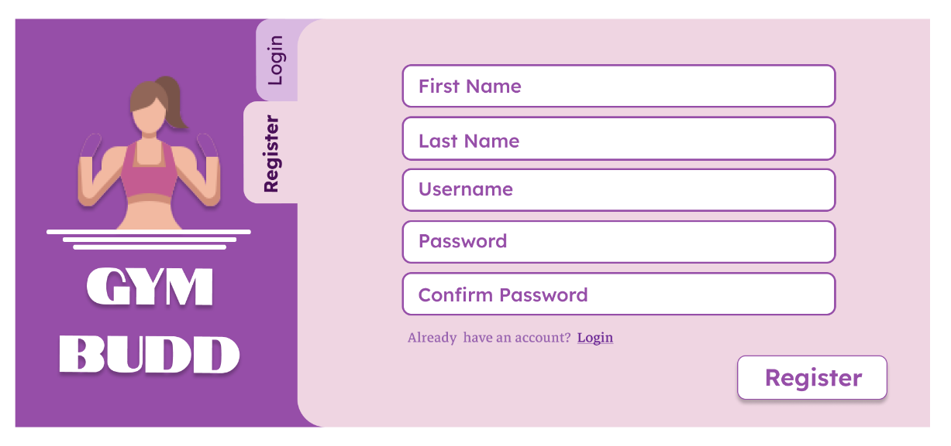

Slide 16
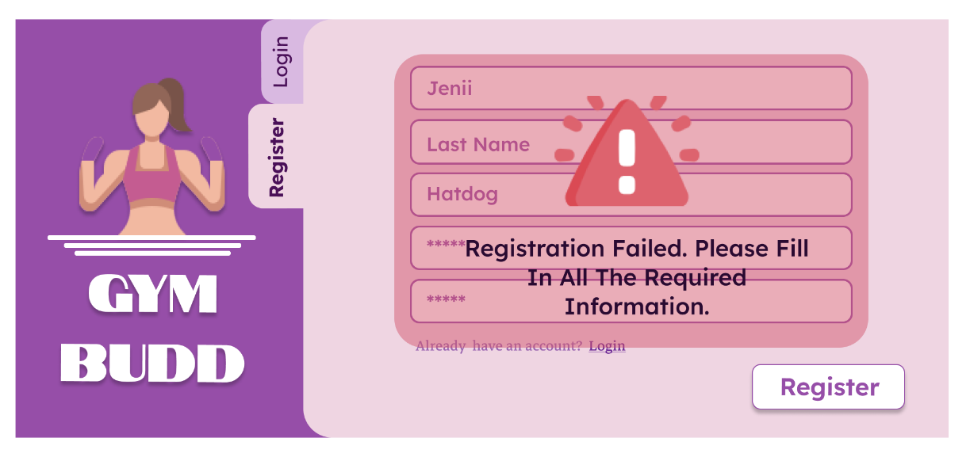

Slide 17
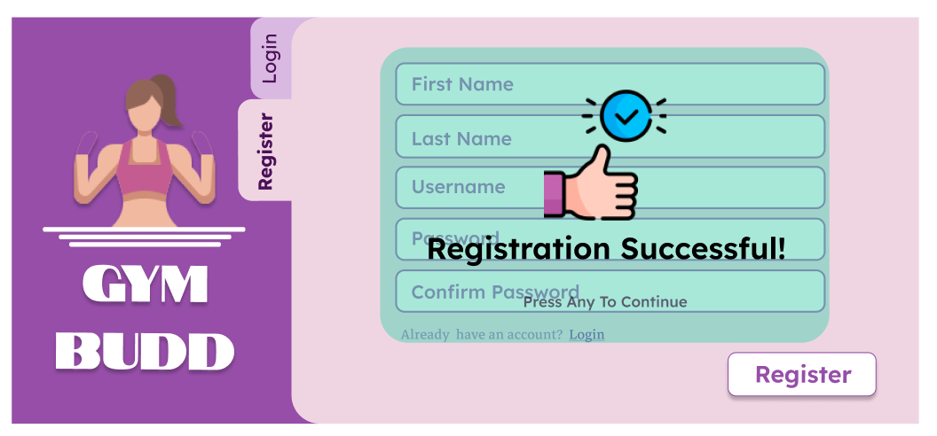

Slide 18


Slide 19


Slide 20


Slide 21
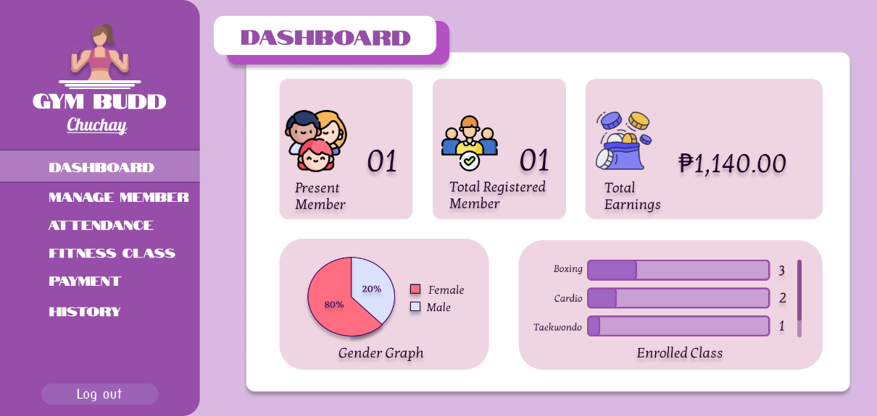

Slide 22
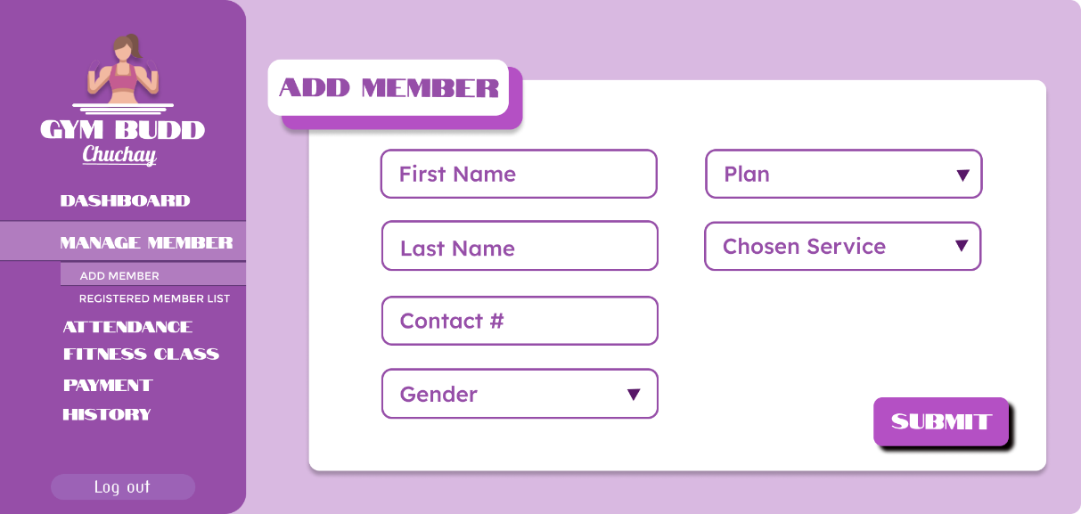

Slide 23
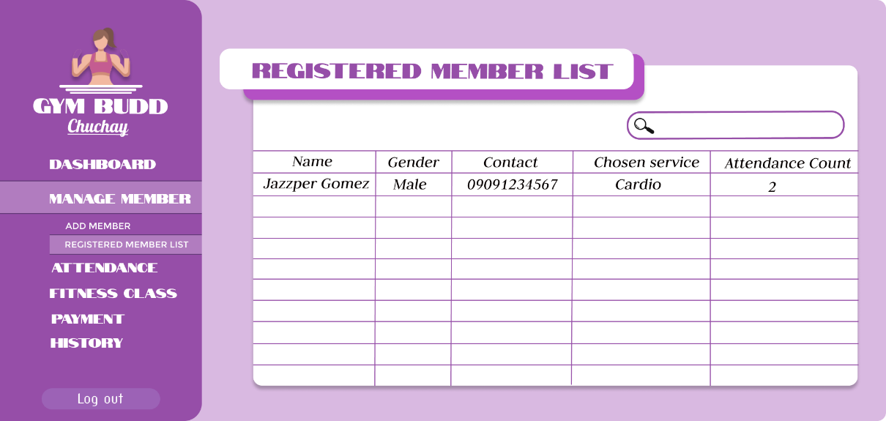

Slide 24
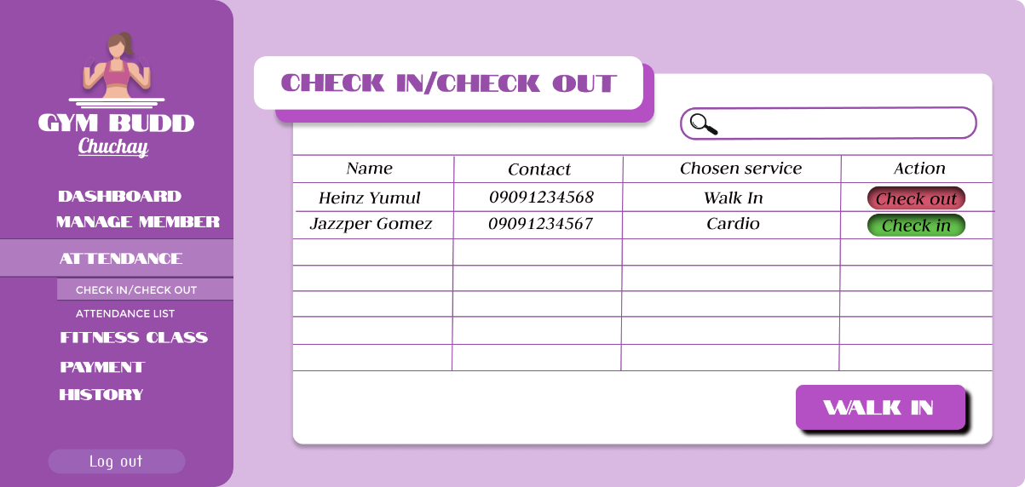

Slide 25
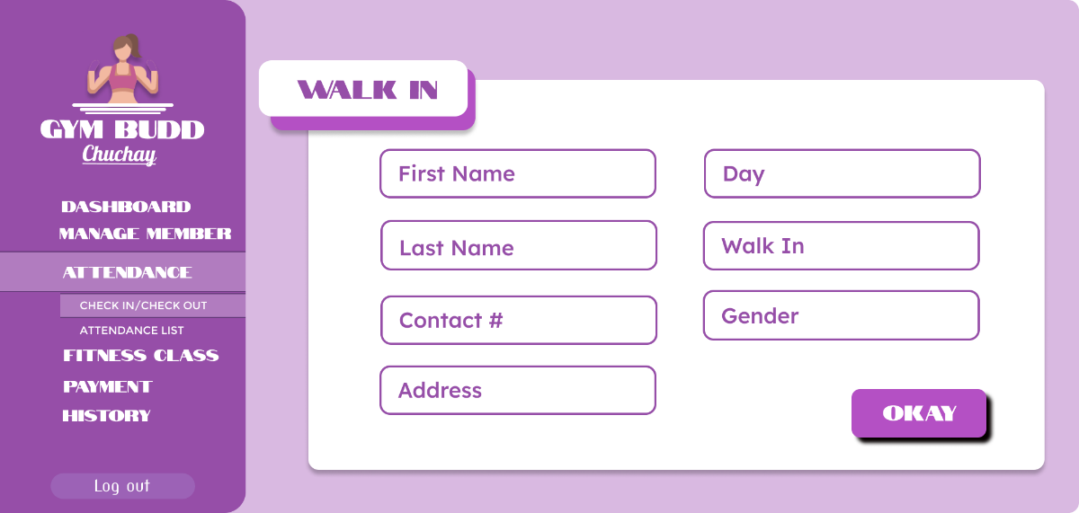

Slide 26
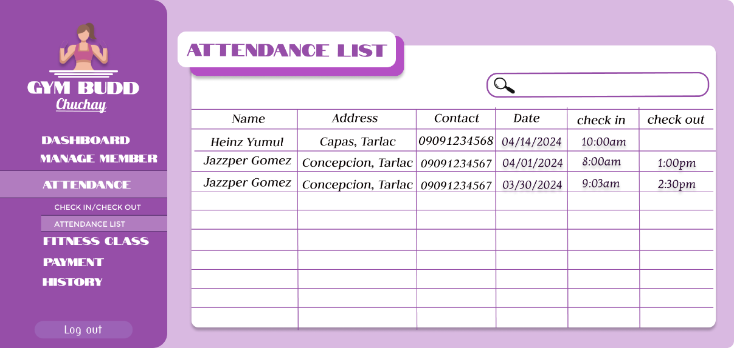

Slide 27
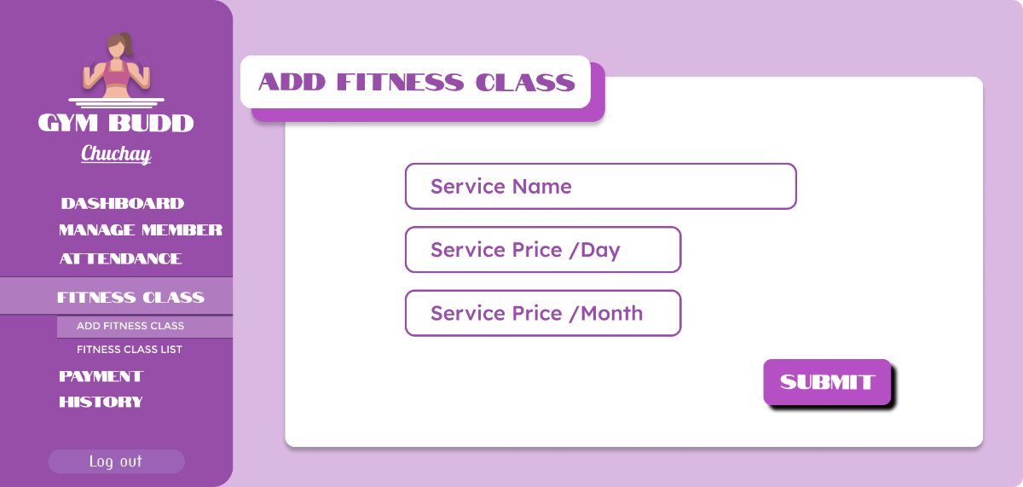

Slide 28
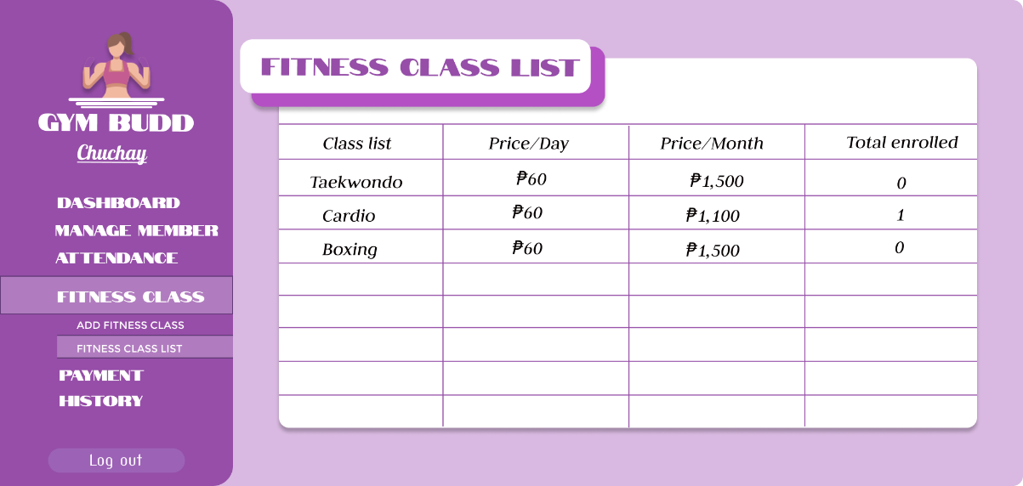

Slide 29
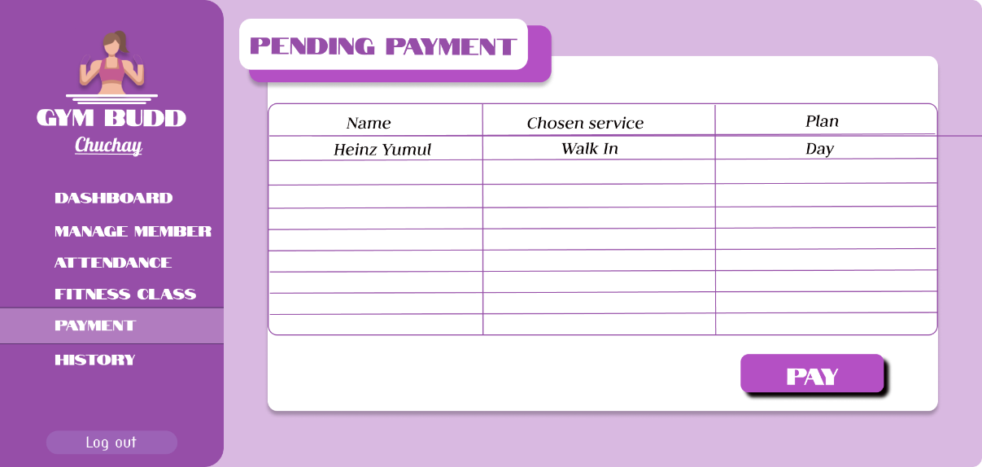

Slide 30
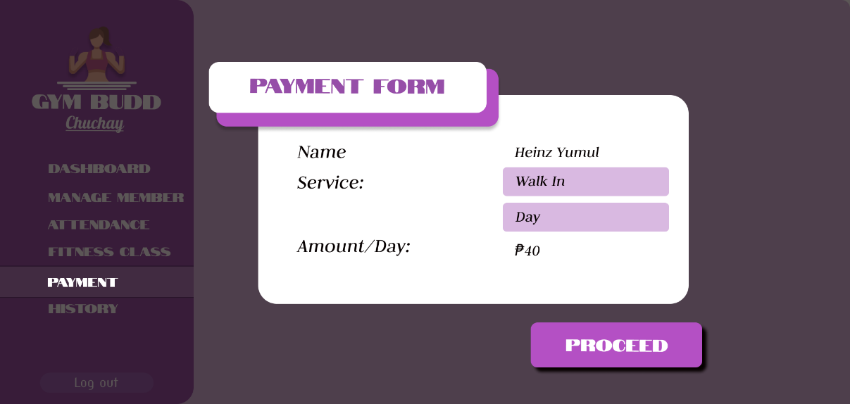
X
Plan

Slide 31
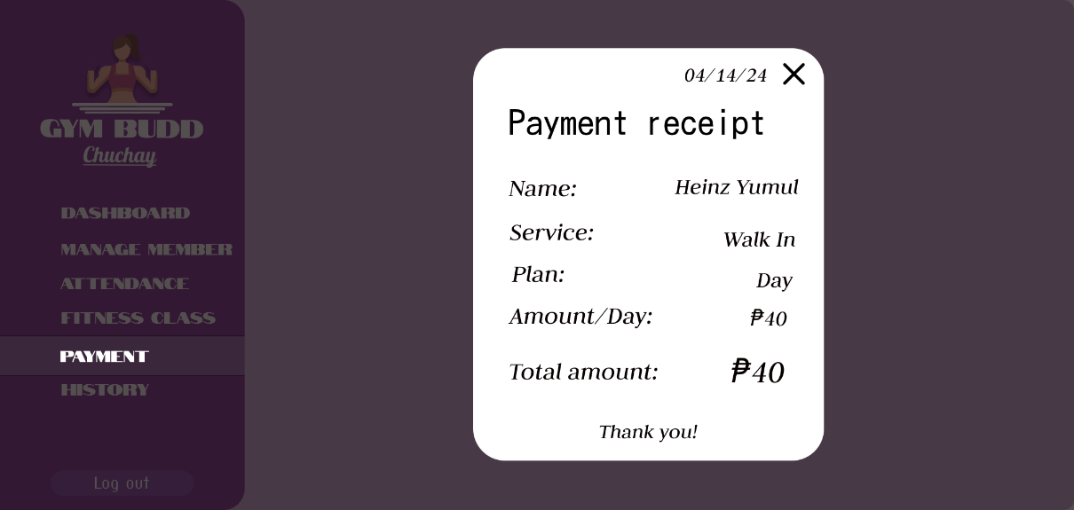

Slide 32
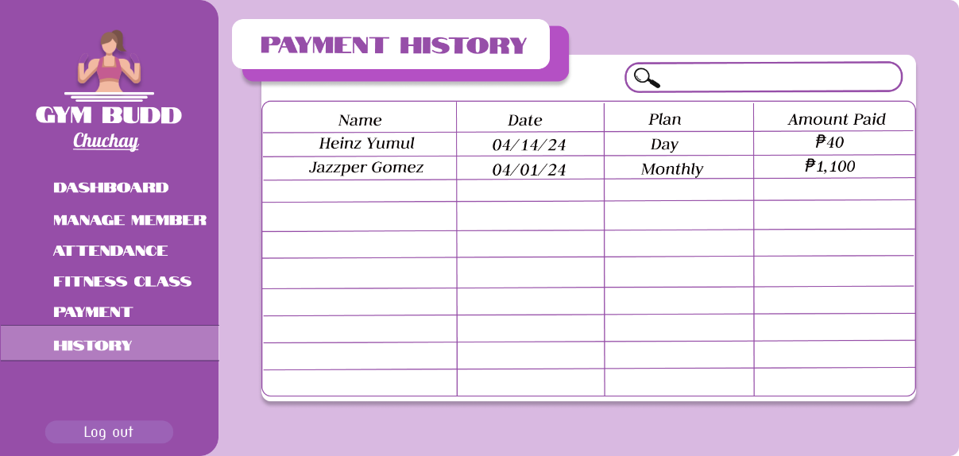

Slide 33
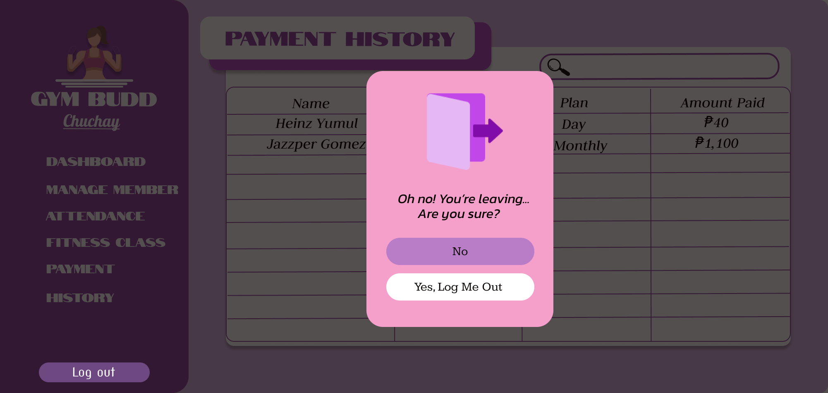

Slide 34
1.4.2 LIMITATIONS
GYMBUDD: A Web-based Application for Gym Enthusiast

Slide 35


Slide 36


Slide 37
2.0 REVIEW OF RELATED LITERATURE / SYSTEMS
GYMBUDD: A Web-based Application for Gym Enthusiast

Slide 38
2.1 REVIEW OF RELATED THEORIES
GYMBUDD: A Web-based Application for Gym Enthusiast

Slide 39
Visual Studio Code
JavaScript
Laragon

Slide 40
2.2 REVIEW OF RELATED PROJECTS
GYMBUDD: A Web-based Application for Gym Enthusiast

Slide 41
2.2.1 REVIEW OF RELATED THESES
GYMBUDD: A Web-based Application for Gym Enthusiast

Slide 42
JK Fitness Office: Web based Gym Management System
Web-Based Management Information System for Services Development: A Literature Review

Slide 43
2.2.2 REVIEW OF RELATED SYSTEMS
GYMBUDD: A Web-based Application for Gym Enthusiast

Slide 44
Wodify
JK Fitness Office

Slide 45
3.0 TECHNICAL BACKGROUND
GYMBUDD: A Web-based Application for Gym Enthusiast

Slide 46
3.1 DEVELOPMENT
GYMBUDD: A Web-based Application for Gym Enthusiast

Slide 47


Hardware

Slide 48

Software

Slide 49

Software

Slide 50

Software

Slide 51

Peopleware

Slide 52


Slide 53
3.1 IMPLEMENTATION
GYMBUDD: A Web-based Application for Gym Enthusiast

Slide 54
Hardware
Software
Peopleware

Slide 55
4.0 METHODOLOGY
GYMBUDD: A Web-based Application for Gym Enthusiast

Slide 56
4.1 Rapid Application Development MODEL
GYMBUDD: A Web-based Application for Gym Enthusiast

Slide 57
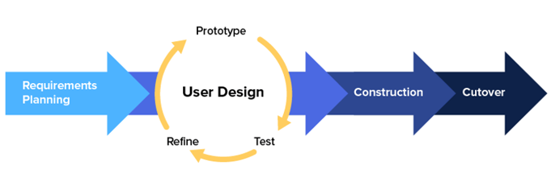

Slide 58
Requirements Planning
User Design

Slide 59
Construction
Cutover

Slide 60
5.0 CONCLUSION AND RECOMMENDATIONS
GYMBUDD: A Web-based Application for Gym Enthusiast

Slide 61
5.1 CONCLUSION
GYMBUDD: A Web-based Application for Gym Enthusiast

Slide 62
5.2 RECOMMENDATION
GYMBUDD: A Web-based Application for Gym Enthusiast

Slide 63


Slide 64


Slide 65


Slide 66


Slide 67
Thank Youuu!<3
GYMBUDD: A Web-based Application for Gym Enthusiast

